Slide 1

SAFETY TALK
Zašto se ljudi povređuju iako smo preduzeli sve mere BZR?

Slide 2


KO SAM JA?
Božinović Zoran

Slide 3

Tradicionalni pristup BZR:
Pokušaji eliminacije rizika
Zaposleni rade poslove zaobilazeći opasnosti
Postavljanje zaštite ili upozorenje zaposlenih na opasnost
Obučavanje radnika da postupaju sa opasnostima na bezbedan način
Notes:
Let’s look at each of the three components in a little more detail.
Your first consideration when you are analyzing at-risk data is to ask yourself if the hazard can be eliminated altogether. Several examples might help illustrate this.
Suppose the at-risk behavior that is of concern is people not using proper lifting techniques for handling tote pans of parts. The first thing you should ask yourself is “How can we eliminate the need to handle tote pans at all?” Can material handling devices be used? If you can’t eliminate the need to handle tote pans, can you change the way they are stored? If they are stored on the floor and the at-risk behavior occurs during the lifting from the floor to the work surface, could you have the tote pans delivered to a raised platform that would reduce the bending required? Could you make the tote pans smaller so they are lighter and more easy to handle?
Behavior based safety doesn’t eliminate the need to look at traditional methods of safely engineering work.

Slide 4
Standardi
Ponovljivost procesa
Kontinuirano poboljšanje
Unapred određeni postupci
Standardizovanje rada
Predefinisano ponašanje
Notes:
Let’s look at each of the three components in a little more detail.
Your first consideration when you are analyzing at-risk data is to ask yourself if the hazard can be eliminated altogether. Several examples might help illustrate this.
Suppose the at-risk behavior that is of concern is people not using proper lifting techniques for handling tote pans of parts. The first thing you should ask yourself is “How can we eliminate the need to handle tote pans at all?” Can material handling devices be used? If you can’t eliminate the need to handle tote pans, can you change the way they are stored? If they are stored on the floor and the at-risk behavior occurs during the lifting from the floor to the work surface, could you have the tote pans delivered to a raised platform that would reduce the bending required? Could you make the tote pans smaller so they are lighter and more easy to handle?
Behavior based safety doesn’t eliminate the need to look at traditional methods of safely engineering work.

Slide 5


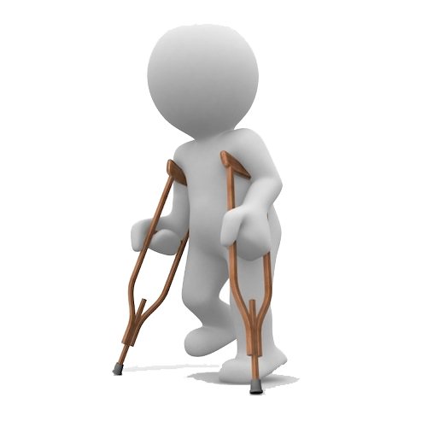

I šta dobijemo?
Notes:
Let’s look at each of the three components in a little more detail.
Your first consideration when you are analyzing at-risk data is to ask yourself if the hazard can be eliminated altogether. Several examples might help illustrate this.
Suppose the at-risk behavior that is of concern is people not using proper lifting techniques for handling tote pans of parts. The first thing you should ask yourself is “How can we eliminate the need to handle tote pans at all?” Can material handling devices be used? If you can’t eliminate the need to handle tote pans, can you change the way they are stored? If they are stored on the floor and the at-risk behavior occurs during the lifting from the floor to the work surface, could you have the tote pans delivered to a raised platform that would reduce the bending required? Could you make the tote pans smaller so they are lighter and more easy to handle?
Behavior based safety doesn’t eliminate the need to look at traditional methods of safely engineering work.

Slide 6

BZR
Sistem upravljanja BZR
Ponašanje
Inženjerske kontrole
Notes:
When you look at the at-risk data and are deciding what types of solutions or interventions to make, always consider each of these three components.
Safety management system - how does the current system that is being used to manage safety in the workplace need to be changed to increase the amount of “safe behavior”?
What engineering controls can be implemented to reduce or eliminate some of the causes of the at-risk behavior that is being observed. If deviated wrists are considered to be “at-risk” posture, what engineering changes need to be made in the job? Redesign of the work zone? Changes in tools and equipment? Elevation of working surfaces or change in their physical orientation? Having a machine perform the tasks that were previously done by hand?
Behavioral interventions - you may provide all the proper tools, training, and adequate supervision but people may still be working in postures or positions that occasionally puts themselves at risk. This may be conscious behavior or unconscious behavior. Look at other job aids that may increase safe behavior awareness. What sort of self monitoring techniques can be employed? How can the necessary behavior changes be shaped and reinforced?
Effective solutions may often require a combination of all 3 approaches.

Slide 7

Šta je za Vas BZR?
Notes:
If the interventions that you choose - whether they are engineering and administrative control changes, safety management system changes, or behavioral interventions - are truly successful there should be an observable, measurable change in behavior - for the better!
% of safe behavior should be increasing for a particular job or department
% of at-risk behavior should be decreasing
people should become more comfortable with reporting near misses or “near hits” as they learn that these occurred because of at-risk behavior and that they represent significant opportunities for improvement
the number of observations should be increasing - the more observations you make, the more data you collect, and if it is good solid data, the greater the confidence you have in your overall assessment of the state of safety in the workplace
people should become more comfortable with making observations and more people should be willing to make them - either formally or informally. Ultimately the culture you want to create is one in which anyone feels comfortable identifying at-risk behavior and bringing it to the forefront so that it can be dealt with in a non-judgmental, proactive manner.
Accident frequency and severity rates should be decreasing as % safe increases
people should become increasingly more responsible and accountable for their own safety related behaviors, accepting feedback openly and honestly with the understanding that it is being offered to improve the overall safety system and not to place fault or blame

Slide 8

Zašto ljudi dolaze na posao ?
Notes:
If the interventions that you choose - whether they are engineering and administrative control changes, safety management system changes, or behavioral interventions - are truly successful there should be an observable, measurable change in behavior - for the better!
% of safe behavior should be increasing for a particular job or department
% of at-risk behavior should be decreasing
people should become more comfortable with reporting near misses or “near hits” as they learn that these occurred because of at-risk behavior and that they represent significant opportunities for improvement
the number of observations should be increasing - the more observations you make, the more data you collect, and if it is good solid data, the greater the confidence you have in your overall assessment of the state of safety in the workplace
people should become more comfortable with making observations and more people should be willing to make them - either formally or informally. Ultimately the culture you want to create is one in which anyone feels comfortable identifying at-risk behavior and bringing it to the forefront so that it can be dealt with in a non-judgmental, proactive manner.
Accident frequency and severity rates should be decreasing as % safe increases
people should become increasingly more responsible and accountable for their own safety related behaviors, accepting feedback openly and honestly with the understanding that it is being offered to improve the overall safety system and not to place fault or blame

Slide 9
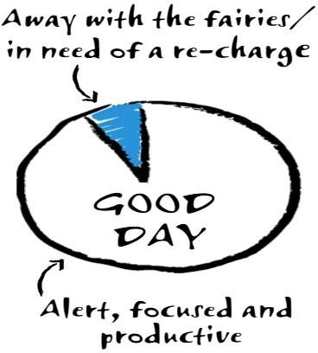
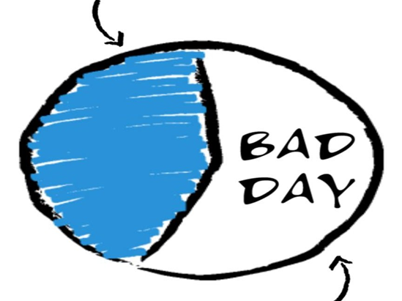
Zašto se onda povređuju?
Odlutao, odsutan, nije tu/
potreban je reset
Odlutao, odsutan, nije tu/
potreban je reset
Kad je loš dan
Kad je sve OK!
Budan, fokusiran i
produktivan
Budan, fokusiran i
produktivan
Notes:
If the interventions that you choose - whether they are engineering and administrative control changes, safety management system changes, or behavioral interventions - are truly successful there should be an observable, measurable change in behavior - for the better!
% of safe behavior should be increasing for a particular job or department
% of at-risk behavior should be decreasing
people should become more comfortable with reporting near misses or “near hits” as they learn that these occurred because of at-risk behavior and that they represent significant opportunities for improvement
the number of observations should be increasing - the more observations you make, the more data you collect, and if it is good solid data, the greater the confidence you have in your overall assessment of the state of safety in the workplace
people should become more comfortable with making observations and more people should be willing to make them - either formally or informally. Ultimately the culture you want to create is one in which anyone feels comfortable identifying at-risk behavior and bringing it to the forefront so that it can be dealt with in a non-judgmental, proactive manner.
Accident frequency and severity rates should be decreasing as % safe increases
people should become increasingly more responsible and accountable for their own safety related behaviors, accepting feedback openly and honestly with the understanding that it is being offered to improve the overall safety system and not to place fault or blame

Slide 10

Zašto se onda povređuju?
Odlutao, odsutan, nije tu/
potreban je reset
Kad je loš dan
Budan, fokusiran i
produktivan
Notes:
If the interventions that you choose - whether they are engineering and administrative control changes, safety management system changes, or behavioral interventions - are truly successful there should be an observable, measurable change in behavior - for the better!
% of safe behavior should be increasing for a particular job or department
% of at-risk behavior should be decreasing
people should become more comfortable with reporting near misses or “near hits” as they learn that these occurred because of at-risk behavior and that they represent significant opportunities for improvement
the number of observations should be increasing - the more observations you make, the more data you collect, and if it is good solid data, the greater the confidence you have in your overall assessment of the state of safety in the workplace
people should become more comfortable with making observations and more people should be willing to make them - either formally or informally. Ultimately the culture you want to create is one in which anyone feels comfortable identifying at-risk behavior and bringing it to the forefront so that it can be dealt with in a non-judgmental, proactive manner.
Accident frequency and severity rates should be decreasing as % safe increases
people should become increasingly more responsible and accountable for their own safety related behaviors, accepting feedback openly and honestly with the understanding that it is being offered to improve the overall safety system and not to place fault or blame

Slide 11

Kako da sačuvamo naše zaposlene?
Notes:
If the interventions that you choose - whether they are engineering and administrative control changes, safety management system changes, or behavioral interventions - are truly successful there should be an observable, measurable change in behavior - for the better!
% of safe behavior should be increasing for a particular job or department
% of at-risk behavior should be decreasing
people should become more comfortable with reporting near misses or “near hits” as they learn that these occurred because of at-risk behavior and that they represent significant opportunities for improvement
the number of observations should be increasing - the more observations you make, the more data you collect, and if it is good solid data, the greater the confidence you have in your overall assessment of the state of safety in the workplace
people should become more comfortable with making observations and more people should be willing to make them - either formally or informally. Ultimately the culture you want to create is one in which anyone feels comfortable identifying at-risk behavior and bringing it to the forefront so that it can be dealt with in a non-judgmental, proactive manner.
Accident frequency and severity rates should be decreasing as % safe increases
people should become increasingly more responsible and accountable for their own safety related behaviors, accepting feedback openly and honestly with the understanding that it is being offered to improve the overall safety system and not to place fault or blame

Slide 12

Šta znači „Čuvajte se“?
Notes:
If the interventions that you choose - whether they are engineering and administrative control changes, safety management system changes, or behavioral interventions - are truly successful there should be an observable, measurable change in behavior - for the better!
% of safe behavior should be increasing for a particular job or department
% of at-risk behavior should be decreasing
people should become more comfortable with reporting near misses or “near hits” as they learn that these occurred because of at-risk behavior and that they represent significant opportunities for improvement
the number of observations should be increasing - the more observations you make, the more data you collect, and if it is good solid data, the greater the confidence you have in your overall assessment of the state of safety in the workplace
people should become more comfortable with making observations and more people should be willing to make them - either formally or informally. Ultimately the culture you want to create is one in which anyone feels comfortable identifying at-risk behavior and bringing it to the forefront so that it can be dealt with in a non-judgmental, proactive manner.
Accident frequency and severity rates should be decreasing as % safe increases
people should become increasingly more responsible and accountable for their own safety related behaviors, accepting feedback openly and honestly with the understanding that it is being offered to improve the overall safety system and not to place fault or blame

Slide 13

Šta znači „Čuvajte jedni druge“?
Notes:
If the interventions that you choose - whether they are engineering and administrative control changes, safety management system changes, or behavioral interventions - are truly successful there should be an observable, measurable change in behavior - for the better!
% of safe behavior should be increasing for a particular job or department
% of at-risk behavior should be decreasing
people should become more comfortable with reporting near misses or “near hits” as they learn that these occurred because of at-risk behavior and that they represent significant opportunities for improvement
the number of observations should be increasing - the more observations you make, the more data you collect, and if it is good solid data, the greater the confidence you have in your overall assessment of the state of safety in the workplace
people should become more comfortable with making observations and more people should be willing to make them - either formally or informally. Ultimately the culture you want to create is one in which anyone feels comfortable identifying at-risk behavior and bringing it to the forefront so that it can be dealt with in a non-judgmental, proactive manner.
Accident frequency and severity rates should be decreasing as % safe increases
people should become increasingly more responsible and accountable for their own safety related behaviors, accepting feedback openly and honestly with the understanding that it is being offered to improve the overall safety system and not to place fault or blame

Slide 14

Šta je suština BZR priče?
Notes:
If the interventions that you choose - whether they are engineering and administrative control changes, safety management system changes, or behavioral interventions - are truly successful there should be an observable, measurable change in behavior - for the better!
% of safe behavior should be increasing for a particular job or department
% of at-risk behavior should be decreasing
people should become more comfortable with reporting near misses or “near hits” as they learn that these occurred because of at-risk behavior and that they represent significant opportunities for improvement
the number of observations should be increasing - the more observations you make, the more data you collect, and if it is good solid data, the greater the confidence you have in your overall assessment of the state of safety in the workplace
people should become more comfortable with making observations and more people should be willing to make them - either formally or informally. Ultimately the culture you want to create is one in which anyone feels comfortable identifying at-risk behavior and bringing it to the forefront so that it can be dealt with in a non-judgmental, proactive manner.
Accident frequency and severity rates should be decreasing as % safe increases
people should become increasingly more responsible and accountable for their own safety related behaviors, accepting feedback openly and honestly with the understanding that it is being offered to improve the overall safety system and not to place fault or blame

Slide 15

Pitanja, komentari, sugestije?
Notes:
If the interventions that you choose - whether they are engineering and administrative control changes, safety management system changes, or behavioral interventions - are truly successful there should be an observable, measurable change in behavior - for the better!
% of safe behavior should be increasing for a particular job or department
% of at-risk behavior should be decreasing
people should become more comfortable with reporting near misses or “near hits” as they learn that these occurred because of at-risk behavior and that they represent significant opportunities for improvement
the number of observations should be increasing - the more observations you make, the more data you collect, and if it is good solid data, the greater the confidence you have in your overall assessment of the state of safety in the workplace
people should become more comfortable with making observations and more people should be willing to make them - either formally or informally. Ultimately the culture you want to create is one in which anyone feels comfortable identifying at-risk behavior and bringing it to the forefront so that it can be dealt with in a non-judgmental, proactive manner.
Accident frequency and severity rates should be decreasing as % safe increases
people should become increasingly more responsible and accountable for their own safety related behaviors, accepting feedback openly and honestly with the understanding that it is being offered to improve the overall safety system and not to place fault or blame

Slide 16

Hvala na pažnji?
Notes:
This quote by Lester Thurow is quite appropriate when we talk about behavior-based safety.
Accidents, near misses, injuries and illnesses in the workplace and at-home do not have to be an accepted norm. Companies that want to be competitive have to become better at eliminating waste. There is no greater waste that the waste of human capabilities, talents and lives because of unsafe working environments. Human capital is truly the most important resource in most organizations today.
Companies that want to become competitive or remain competitive are those that will be the best at managing safety in the workplace. That will require change in how we approach safety. Behavior based safety techniques offer another important tool for doing this.
Or as Mr. Thurow states, “You can lose”. Which do you want to do?

